Slide 1
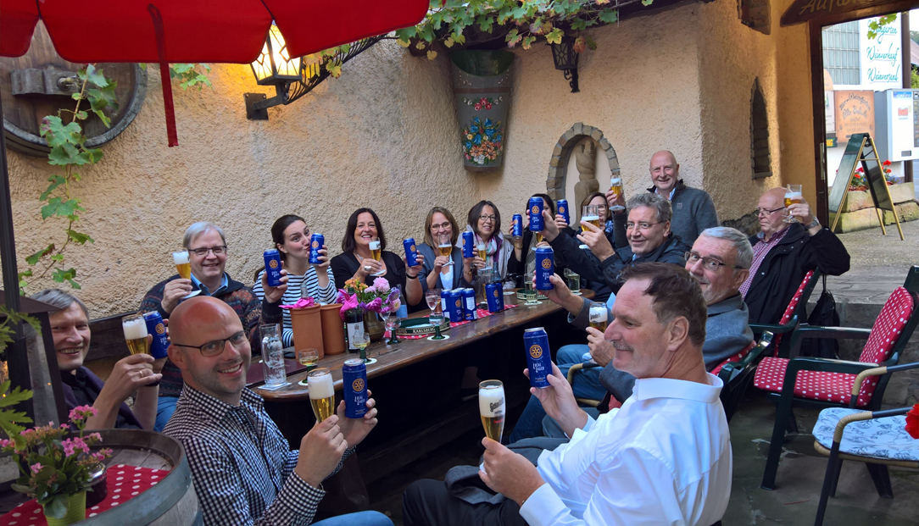
Cheers!!! – How to Make Friends & Influence People
“Share Rotary Local Lager”

Slide 2

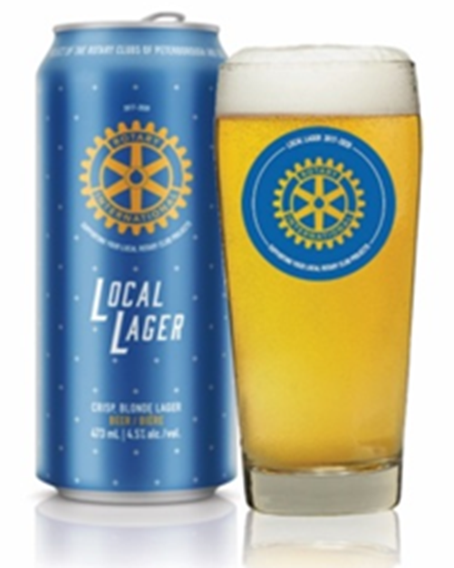

“Rotary Local Lager”
A Win - Win - Win
Opportunity
A great tasting
“Crisp Refreshing Blonde Lager”
and
An opportunity to
Support and raise funds for Rotary funded projects in your community and Rotary water filtration projects around the globe.

Slide 3

Background /
Key Contacts
The Rotary Club of Peterborough and the Rotary Club of Guelph launched Rotary Local Lager – a major fundraising initiative developed in collaboration with Wellington Brewery on Wednesday August 30th 2017
The Rotary International sanctioned initiative provides the opportunity for development of an on-going funding source for participating Rotary clubs across Ontario to support their community initiatives.
Kevin M. Duguay
Rotary Club of Peterborough
Email: kevin@kmdplanning.com
Phone: 705-931-0975
Sarah Dawkins
Wellington Brewery
Email: sarah@wellingtonbrewery.ca
Phone: 519-837-2337 ext. 222
Helmuth Slisarenko
Rotary Club of Guelph
Email: h_slis@rogers.com
Phone: 519-820-6455

Slide 4
Opportunities / Benefits
Club / Community Participation
  Register with the Beer Store / Wellington Brewery - (See Sign up Form & Q&A Sheet)
    RLL delivery within 10-14 days / buy your beer / engage the public and community bars, pubs, hotels, and clubs to buy and sell RLL
    50 cents per can donated to Rotary (20 cents to participating clubs, 20 cents split between to RC Peterborough & Guelph to cover program development costs and raise funds for club and community initiatives and 10 cents to Rotary International to support Rotary Funded Water Filtration Projects around the world.
  Sale of Beer @ Rotary / Community Events
    e.g. Rib Fest, Golf Tournaments / Fishing Derbies / Barbecues / Music Festivals / Other Fund Raisers
    Retail margin benefit $2-5 per can depending on retail pricing $5-8 per can
  Gift Pack Sales
    Opportunity to spread RLL story – Give a RLL Gift Pack to your dinner party host / Christmas gift to family members / employees / customers / suppliers
    Potential margin $5 per pack plus 20 cents per can.

Slide 5
Products & Support
Rotary Local Lager
  Crisp Blonde Refreshing Lager
    473 ml cans / 4.5% alcohol / all natural ingredients
  Current Distribution
    Brewers Retail / Wellington Brewery Direct
    Food Retail / LCBO - Future considerations
  Cost
    Single - $3.10 / Six Pack - $3.00 / Case 24 - $2.88 including applicable taxes
Gift Packs – Current
    4 Beers / 2 Glasses + 4 Coasters
    Cost - $25.00 – Free Club Delivery with 60 pack order
Promotional Materials / Support
    Free Starter Kits including: Glasses, Coasters, Posters, & promotional templates for Business Cards, Facebook ads etc.
    Website www.rotarylocallager.ca (in the works)
    Guelph / Peterborough / Wellington Project Team Support

Slide 6
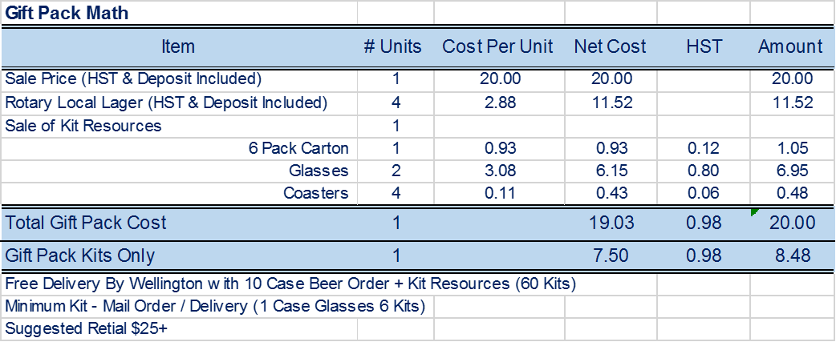
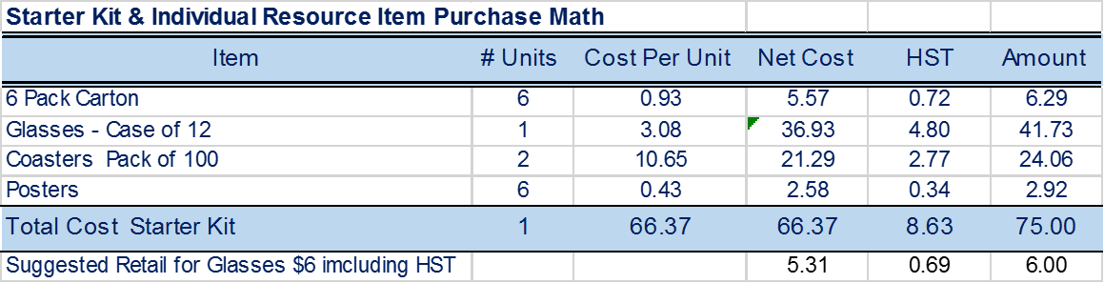
Products & Support

Slide 7
Marketing &
Promotional Programs
Current RLL Project Team Activity
  Announce Program – Generate awareness of program potential
    Generate network of participating clubs and / clusters
    Identify club / cluster champions – e.g. Kitchener, London
  Develop & test marketing and promotional programs
    In Guelph & Peterborough and participating clubs
  Collaborate in developing formal coordinated community launch with participating clubs / clusters in advance of May 24 weekend
    Plans & launch program ready by April 30th 2018
    Work with RI / 7070 / Toronto clubs re RI Convention Program
    Develop year 2-3 plan and program for 2019 / 2020
  On- Going Communications:
    Club / Cluster visits / Website & Social Media Program Development / Quarterly updates & payments
    Year 1 results to clubs @ District Conferences in the Fall 2018

Slide 8
Considerations
For Participating Clubs
  Decide on whether and how you want to participate in the program
  Identify your Champion / Project Team
    Consider developing a Joint Community Program with neighbouring clubs - (Community Wide Marketing & Cost Benefits)
    Initiate a gift pack program with club members
  Identify:
    Destination program with strong public appeal for funds raised
      buying RLL will benefit this / these initiatives
    Rotary / Community Events for possible RLL sales
    Potential community sales partners:
      Bars, Restaurants , Hotels, Clubs e.g. Curling, Golf, The Legion
    Meet with prospective partners, event organizers
  Develop a plan for 2018 with April 30th launch date
RLL is a great product with a great opportunity to engage your community and your summer visitors and raise funds for community and Rotary Initiatives

Slide 9
Considerations
For RCOG Members
Support the Project
  Buy and enjoy Rotary Local Lager
    IT IS a great tasting “Crisp Refreshing Blonde Lager”
    A great beer supporting great work within your community and water filtration projects around the globe
    Consider a Gift Pack to celebrate birthdays, special events, hosts of dinner parties or say thanks to great customers and suppliers etc.– you are guaranteed to have a great conversation about Rotary and Rotary Local Lager
  Encourage the Club to consider dedicating year 1 funds raised from the Rotary Local Lager Project to a new Rotary initiative
    An opportunity to communicate the benefits of both Win-Win-Win propositions and initiatives at the same time to family, friends, colleagues, neighbours, customers, suppliers etc.
  Join the Sales & Project Support Team
    Share the story (directly & via your social media)
    Encourage community & organizational event managers and local bar, club, restaurant to consider offering Rotary Local Lager at their respective events and establishments
    Join the team / Encourage & help other clubs to join the program
  Help Make Rotary Local Lager Available Province Wide

